Slide 1


Statistical Learning Methods
Assistant Professor
IT-ICT Department, LJIET
prayag.patel@ljinstitutes.edu.in
Mr. Prayag Patel

Slide 2
Outline
Statistical Learning,
Learning with Complete Data
Learning with Hidden Variables: EM Algorithm
Mr. Prayag Patel
Department: IT/ICT-LJIET

Slide 3
Statistical Learning
Statistical Learning in Artificial Intelligence is a set of tools for machine learning that uses statistics and functional analysis.
Statistical learning based on the learning of uncertainty in real environments.
In simple words, Statistical learning is understanding from training data and predicting on unseen data.
Statistical learning is used to build predictive models based on the data.
Mr. Prayag Patel
Department: IT/ICT-LJIET

Slide 4
Statistical Learning
Two Key concepts are:
  Data:
    Gathering Information.
    Measuring Information.
    Data are evidence.(Samples and population)
  Hypotheses:
    A hypothesis is an explanation for something.
    It is a provisional idea, an educated guess that requires some evaluation.
Mr. Prayag Patel
Department: IT/ICT-LJIET

Slide 5
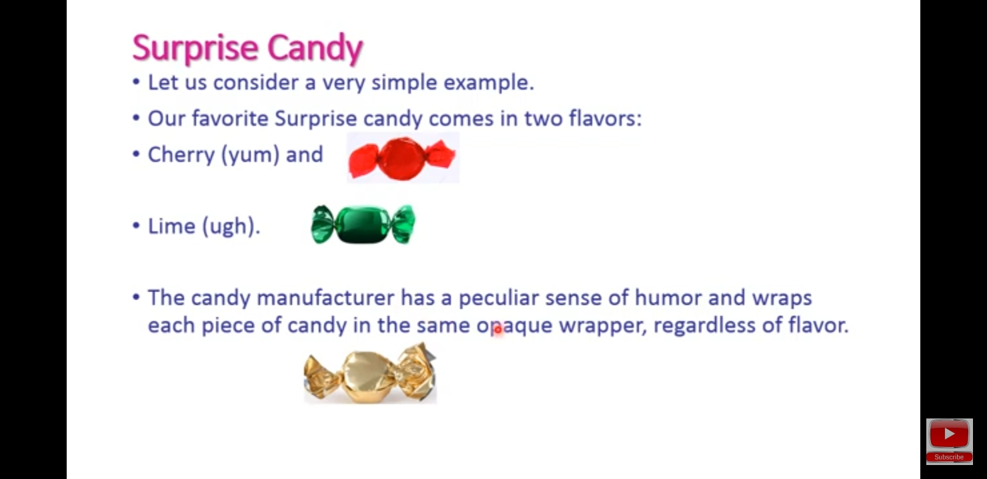
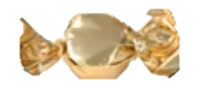
Statistical Learning
Surprise candy comes in Two flavors:
  cherry
  lime
Each piece of candy is wrapped in the same non-transparent wrapper, regardless of flavor.
Mr. Prayag Patel
Department: IT/ICT-LJIET

Slide 6
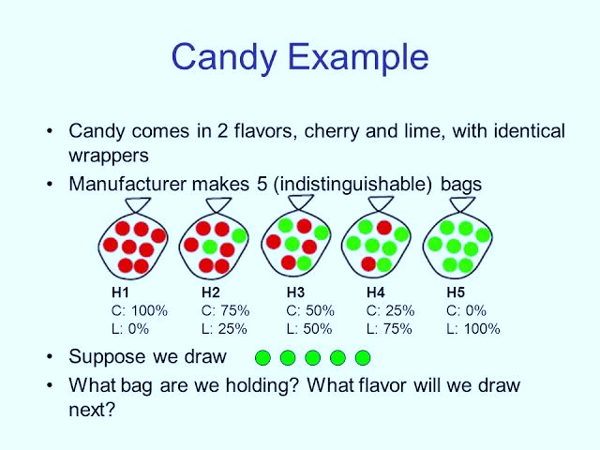
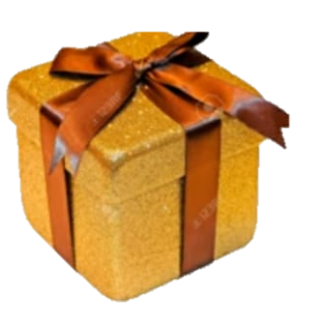
Statistical Learning
Five kinds of bags of candy are indistinguishable from the outside
ℎ1: 100% 𝑐ℎ𝑒𝑟𝑟𝑦
ℎ2: 75% 𝑐ℎ𝑒𝑟𝑟𝑦 + 25% 𝑙i𝑚𝑒
ℎ3: 50% 𝑐ℎ𝑒𝑟𝑟𝑦 + 50% 𝑙i𝑚𝑒
ℎ4: 25% 𝑐ℎ𝑒𝑟𝑟𝑦 + 75% 𝑙i𝑚𝑒
ℎ5: 100% 𝑙i𝑚𝑒
Given a new Bag of candy, Random variable 𝐻 denotes the type of the bag with possible values h1 through h5 and observation variables 𝐷1, , 𝐷𝑛 are the flavors of opened candies(Charry or Lime).
The task is to predict the flavor of the next piece of candy
Mr. Prayag Patel
Department: IT/ICT-LJIET

Slide 7
Statistical Learning
Bayesian learning simply calculates the probability of each hypothesis, given the data D, with observed value d.
Using Bayes’ rule Probability of each hypothesis:
𝑃(ℎ_{i} | d) = 𝛼 𝑃(d | ℎ_{i}) 𝑃(ℎ_{i})
When we want to make a prediction about an unknown quantity X, then we have
P(X | d) = ∑ P(X | d, ℎ_{i}) P(ℎ_{i} | d)
i
= ∑ P( X | ℎ_{i}) 𝑃(ℎ_{i} | d)
i
We have assumed that each hypothesis ℎ_{i} determines a probability distribution over X
Predictions are weighted averages over the predictions of individual hypothesis
Mr. Prayag Patel
Department: IT/ICT-LJIET

Slide 8
Statistical Learning
The key quantities in the Bayesian approach are the hypothesis prior, 𝑃(ℎi), and the likelihood of the data under each hypothesis,
𝑃(d | ℎ_{i} )
Let the prior distribution of candy bag types ℎ1,… , ℎ5 be (Manufacturing company announces that)
    0.1, 0.2, 0.4, 0.2, 0.1 means (10%, 20%, 40%, 20%,10%)
We make the i.i.d.-assumption (independently and identically distributed) concerning the observations: each observation is independent of the others and is drawn from the same probability distribution, hence
𝑃(d | ℎi) = ∏ 𝑃(𝑑_{j} | ℎ_{i})
j
E.g., suppose the bag is really an all-lime bag (ℎ5) and the first 10 candies are all lime; then 𝑃(d | ℎ₃) = 0.5¹⁰ ≈ 0.001
Mr. Prayag Patel
Department: IT/ICT-LJIET

Slide 9
Statistical Learning
Because ℎ₃ has the highest prior probability, it is initially the most likely hypothesis.
Observing one piece of candy with lime flavor, does not yet change the situation, but already after two lime candies ℎ₄ becomes the most likely hypothesis.
Starting after three lime observations (the correct bag) ℎ₅is the most likely.
Hence, the correct hypothesis will eventually dominate the prediction.
The predicted probability that the next candy is lime increases monotonically toward 1.
The Bayesian prediction eventually agrees with the true hypothesis.
Mr. Prayag Patel
Department: IT/ICT-LJIET

Slide 10
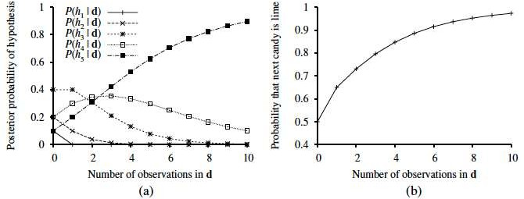
Statistical Learning
Figure(a) Posterior probabilities P(hi | d1, . . . , dN) from Equation 𝑃(ℎ_{i} | d) = 𝛼 𝑃(d | ℎ_{i}) 𝑃(ℎ_{i}).The number of observations N ranges from 1 to 10, and each observation is of a lime candy. Figure (b) Bayesian prediction P(dN+1 =lime | d1, . . . , dN) from Equation P(X | d) = ∑ P( X | ℎ_{i}) 𝑃(ℎ_{i} | d)
i
Mr. Prayag Patel
Department: IT/ICT-LJIET

Slide 11
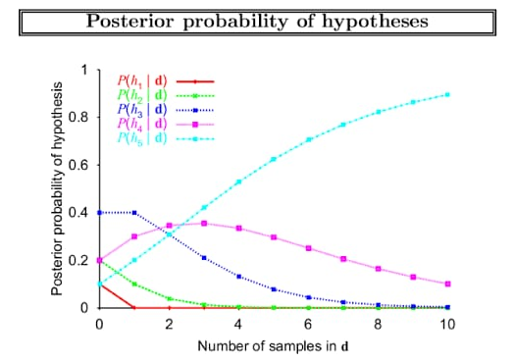
Statistical Learning
Mr. Prayag Patel
Department: IT/ICT-LJIET

Slide 12
Statistical Learning
Any fixed prior that does not rule out the true hypothesis, the posterior probability of any false hypothesis will (under certain technical conditions) eventually vanish
This happens simply because the probability of generating “uncharacteristic” data indefinitely is vanishingly small
The Bayesian prediction is optimal: any other prediction is expected to be correct less often (given the hypothesis prior)
For real learning problems, the hypothesis space is usually very large or infinite
In some cases, the summation (or integration, in the continuous case) over the hypothesis class can be carried out manageable, but in most cases we must resort to approximate or simplified methods
Mr. Prayag Patel
Department: IT/ICT-LJIET

Slide 13
Statistical Learning
A very common approximation is to make predictions based on a single most probable; i.e., the one that maximizes the value
  𝑃(ℎi | d)
This is often called a maximum a posteriori (MAP) hypothesis ℎ_{MAP}
As more data arrive, the MAP prediction P(X | ℎ_{MAP} ) and Bayesian prediction P(X | d) become closer, because the competitors to MAP hypothesis become less and less probable
Instead of a summation (or integration) we now have to solve an optimization problem
In our candy bag example, after three pieces of candy
ℎ_{MAP} = ℎ₅ and the fourth candy is predicted to have lime flavor with probability 1.0, while the true Bayesian probability (averaged over all hypotheses) would be 0.8
Mr. Prayag Patel
Department: IT/ICT-LJIET

Slide 14
Statistical Learning
To guard against overfitting Bayesian and MAP learning methods penalize complex hypotheses with a low prior probability
More complex hypotheses have a greater capacity to fit the data
If, e.g., 𝐻 contains only deterministic hypotheses, then 𝑃(d | ℎ_{i}) is 1 if ℎ_{i} is consistent and 0 otherwise
Then ℎ_{MAP} is, in the spirit of Occam’s razor, the simplest logical theory that is consistent with the data
On the other hand, choosing ℎ_{MAP} to maximize 𝑃(d | ℎ_{i}) 𝑃(ℎ_{i}) is equivalent to minimizing
    − log₂ 𝑃(d | ℎ_{i} ) − log2𝑃(ℎ_{i} )
The − log₂𝑃(ℎ_{i} ) term equals the number of bits required to specify the hypothesis ℎ_{i}
Mr. Prayag Patel
Department: IT/ICT-LJIET

Slide 15
Statistical Learning
Furthermore, − log₂ 𝑃(d | ℎ_{i} ) is the additional number of bits required to specify the data, given the hypothesis
E.g. if the hypothesis predicts the data exactly (𝑃 (d|ℎ_{i}) = 1), then no extra bits are required (log₂ 1 = 0)
Hence, MAP learning is choosing the hypothesis that provides maximum compression of the data (cf. MDL principle by Rissanen)
Assuming a uniform prior over the space of hypotheses, reduces MAP learning to choosing an ℎ_{i} that maximizes the likelihood of data 𝑃 (d|ℎ_{i} )
Maximum-likelihood (ML) learning provides a good approximation to Bayesian and MAP learning when the data set is large, but it has problems with small data sets
Mr. Prayag Patel
Department: IT/ICT-LJIET

Slide 16
Learning with Complete Data
Density estimation
  The general task of learning a probability model, given data that are assumed to be generated from that model
  This section covers the simplest case, where we have complete data
    Data are complete when each data point contains values for every variable in the probability model being learned
    Parameter learning
      Finding the numerical parameters for a probability model whose structure is fixed(Marks & Behavior)
Mr. Prayag Patel
Department: IT/ICT-LJIET

Slide 17
Learning with Complete Data
1) Maximum likelihood parameter learning: Discrete models.
A probability model (Bayesian network) has a fixed structure, we try to determine the values of its numerical parameters (conditional probabilities)
We assume that the observations are complete; i.e., each data point contains values for every variable in the probability model being learned
In a Bag of lime and cherry candy from a new manufacturer whose lime-cherry proportions are completely unknown that is the fraction could be any where between 0 and 1.
Mr. Prayag Patel
Department: IT/ICT-LJIET

Slide 18
Learning with Complete Data
1) Maximum likelihood parameter learning: Discrete models.
If the proportions of cherry-lime flavor in a candy bag can be arbitrary, there is a continuum of hypotheses
Let the proportion of cherry candies in a bag be 𝜃, it is the only parameter and the corresponding hypothesis is ℎ𝜃
The Bayesian network needs to have a node corresponding to a single random variable (𝐹𝑙𝑎𝑣𝑜𝑟), which can assume values
𝑐ℎ𝑒𝑟𝑟𝑦 (with probability 𝜃) and 𝑙i𝑚𝑒 (with probability 1 − 𝜃)
Mr. Prayag Patel
Department: IT/ICT-LJIET

Slide 19
Learning with Complete Data
1) Maximum likelihood parameter learning: Discrete models.
Suppose we unwrap 𝑁 candies, out of which 𝑐 pieces turn out to be cherry flavored and 𝑃 = 𝑁 − 𝑐 pieces of lime flavor
We assume all flavor mix ratios to be equally probable a priori
maximum-likelihood approach
𝑁
𝑃(d |ℎ_{𝜃} ) = ∏ 𝑃(𝑑_{j} | ℎ_{𝜃} ) = 𝜃^{𝑐} (1 − 𝜃)^{𝑃}
j=1
The maximum-likelihood hypothesis is given by the value 𝜃 that maximizes this expression
The same value is obtained by maximizing the logarithm of the likelihood (log likelihood)
    𝐿 (d |ℎ_{𝜃} ) = log 𝑃 (d | ℎ_{𝜃} )
𝑁
= ∑ log 𝑃(𝑑_{j} | ℎ_{𝜃} )
j=1
= 𝑐 log 𝜃 + 𝑃 log(1 − 𝜃)
Mr. Prayag Patel
Department: IT/ICT-LJIET

Slide 20
Learning with Complete Data
1) Maximum likelihood parameter learning: Discrete models.
Thus, the product over the data reduces to a sum over the data, which is usually easier to maximize
Differentiating 𝐿 with respect to 𝜃 and setting the resulting expression to zero gives the maximum-likelihood value of 𝜃
𝑑𝐿(𝑑 | ℎ𝜃)/𝑑𝜃 = 𝑐/𝜃 − 𝑃/(1 − 𝜃) = 0
𝜃 = 𝑐/(𝑐 + 𝑃) = 𝑐/𝑁
The maximum-likelihood hypothesis ℎ_{ML} declare that the actual proportion of cherries in the bag is equal to as the observed proportion in the candies unwrapped so far
This approach can be used more generally to disclose the values of more than one parameters
Mr. Prayag Patel
Department: IT/ICT-LJIET

Slide 21
Learning with Complete Data
1) Maximum likelihood parameter learning: Discrete models.
A significant problem of the approach: if some events have not yet been observed (in a small enough data set), then ℎ_{ML} declare zero probability to those events
Let us change the example so that, depending on the flavor of the candy, it is wrapped by a probabilistic rule either in red or green wrapper
𝐹𝑙𝑎𝑣𝑜𝑟
𝑃(𝑐ℎ𝑒𝑟𝑟𝑦)
Unknown proportion of cherries and limes.
𝜃
Wrapper color depends on the candy flavor.
𝐹𝑙𝑎𝑣𝑜𝑟 | 𝑃(𝑟𝑒𝑑 | 𝐹)
𝑐ℎ𝑒𝑟𝑟𝑦 | 𝜃₁
𝑙i𝑚𝑒 | 𝜃₂
W𝑟𝑎𝑝𝑝𝑒𝑟
Mr. Prayag Patel
Department: IT/ICT-LJIET

Slide 22
Learning with Complete Data
1) Maximum likelihood parameter learning: Discrete models.
Now the probability model has three parameters 𝜃, 𝜃₁, and 𝜃₂
From the standard semantics of Bayesian networks, we can compute likelihoods of events, e.g.
𝑃(𝐹𝑙𝑎𝑣𝑜𝑟 = 𝑐ℎ𝑒𝑟𝑟𝑦, W𝑟𝑎𝑝𝑝𝑒𝑟 = 𝑔𝑟𝑒𝑒𝑛| ℎ_{𝜃,𝜃1,𝜃2})
= 𝑃(𝐹𝑙𝑎𝑣𝑜𝑟 = 𝑐ℎ𝑒𝑟𝑟𝑦 | ℎ_{𝜃,𝜃1,𝜃2} )
𝑃(W𝑟𝑎𝑝𝑝𝑒𝑟 = 𝑔𝑟𝑒𝑒𝑛 | 𝐹𝑙𝑎𝑣𝑜𝑟 = 𝑐ℎ𝑒𝑟𝑟𝑦, ℎ_{𝜃,𝜃1,𝜃2} )
= 𝜃(1 − 𝜃1)
Now we unwrap 𝑁 candies, of which 𝑐 are cherries and 𝑃 are limes. The corresponding wrapper counts are 𝑟_{𝑐}, 𝑔_{𝑐}, 𝑟_{𝑃}, and 𝑔_{𝑃}
Mr. Prayag Patel
Department: IT/ICT-LJIET

Slide 23

Learning with Complete Data
1) Maximum likelihood parameter learning: Discrete models.
The likelihood of the data 𝑃( d | ℎ_{𝜃,𝜃1,𝜃2} ) is
Taking logarithms simplifies the expression:
𝐿 = [𝑐 log 𝜃 + 𝑃 log(1 − 𝜃)] + [𝑟_{𝑐} log 𝜃₁ + 𝑔_{𝑐} log(1 − 𝜃₁)]
+[𝑟_{𝑃} log 𝜃₂ + 𝑔_{𝑃} log(1 − 𝜃₂)]
When we take derivatives with respect to each parameter and set them to zero, we get
Mr. Prayag Patel
Department: IT/ICT-LJIET

Slide 24
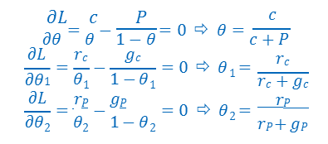
Learning with Complete Data
1) Maximum likelihood parameter learning: Discrete models.
The solution for 𝜃 is the same as before
The solution for 𝜃₁ is the observed fraction of cherry candies with red wrappers, and similarly for 𝜃₂
The maximum-likelihood parameter learning problem for a Bayesian network decomposes into separate learning problems – one for each parameter
Mr. Prayag Patel
Department: IT/ICT-LJIET

Slide 25
Learning with Complete Data
2) Naïve Bayes Models
The most common Bayesian network model used in machine learning is the Naïve Bayes Model.
The class variable 𝐶 is the root of the Bayesian network and the attribute variables X_{i} are its leaves.
The naïve assumption is that the attributes are conditionally independent of each other given the class.
Mr. Prayag Patel
Department: IT/ICT-LJIET

Slide 26
Learning with Complete Data
2) Naïve Bayes Models
Assuming Boolean variables, the parameters are
𝜃 = 𝑃(𝐶 = 𝑡𝑟𝑢𝑒)
𝜃_{i1} = 𝑃(X_{i} = 𝑡𝑟𝑢𝑒 | 𝐶 = 𝑡𝑟𝑢𝑒)
𝜃_{i2} = 𝑃(X_{i} = 𝑡𝑟𝑢𝑒 | 𝐶 = ƒ𝑎𝑙𝑠𝑒)
The maximum-likelihood parameter values are found exactly the same way as before. Once the model has been trained, then observation [𝑥₁, … , 𝑥_{𝑛}], for which the class variable 𝐶 is unobserved, can be classified
P(𝐶 | 𝑥₁,…, 𝑥_{𝑛}) = 𝛼 P(𝐶) ∏_{i} P(𝑥_{i} | 𝐶)
Mr. Prayag Patel
Department: IT/ICT-LJIET

Slide 27

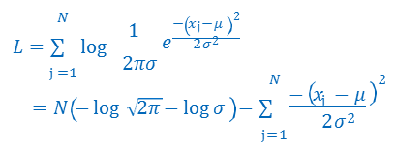
Learning with Complete Data
3) Maximum likelihood parameter learning: Continuous models.
Let us examine learning the parameters of a Gaussian density function on a single variable
The data are generated by:
The parameters of the model are mean 𝜇 and standard deviation 𝜎
Let the observed values be 𝑥₁,…, 𝑥_{𝑁}
Then the log likelihood is
Mr. Prayag Patel
Department: IT/ICT-LJIET

Slide 28
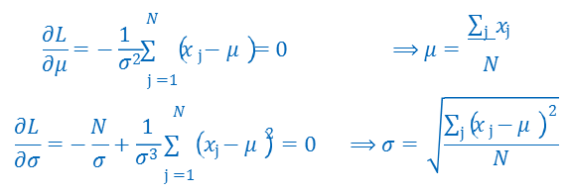
Learning with Complete Data
3) Maximum likelihood parameter learning: Continuous models.
Setting partial derivatives to zero yields :
That is, the maximum-likelihood value of the mean is simple average and The maximum-likelihood value of the standard deviation is the square root of the sample variance
Again, these are the Automatic correct values
Mr. Prayag Patel
Department: IT/ICT-LJIET

Slide 29
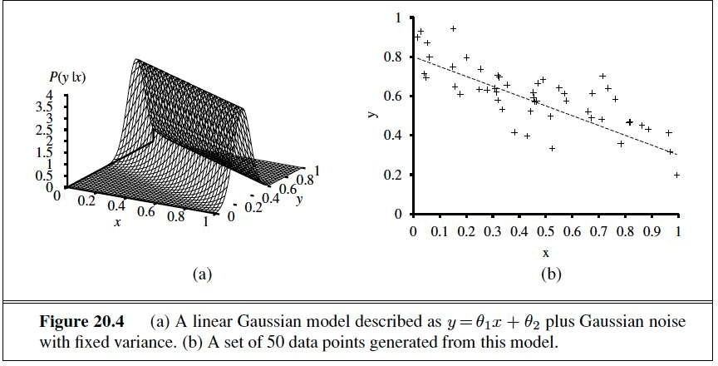
Learning with Complete Data
3) Maximum likelihood parameter learning: Continuous models.
Mr. Prayag Patel
Department: IT/ICT-LJIET

Slide 30
Learning with Complete Data
4) Bayesian parameter learning
The problem with maximum-likelihood (ML) learning is its deficiencies with small data sets
After seeing one cherry candy, the ML hypothesis is that the bag is 100% cherry (𝜃 = 1.0), which is not a reasonable conclusion
In the Bayesian approach to parameter learning, we first set hypothesis priors, and then as the data arrives, update the posterior probability distribution
In the Bayesian view 𝜃 is the (unknown) value of a random variable Θ that defines the hypothesis space; the hypothesis prior is just the prior distribution P(Θ)
Mr. Prayag Patel
Department: IT/ICT-LJIET

Slide 31
Learning with Complete Data
4) Bayesian parameter learning
If the parameter 𝜃 can be any value between 0 and 1, then P(Θ) must be a continuous distribution that is nonzero only between 0 and 1 and integrates to 1
The uniform density 𝑃(𝜃) = Uniform[0, 1](𝜃) is one candidate
It turns out that the uniform density is a member of beta distributions
Each beta distribution is defined by two hyperparameters 𝑎 and 𝑏 such that
beta[𝑎, 𝑏](𝜃) = 𝛼 𝜃^{𝑎−1}(1 − 𝜃)^{𝑏−1} for 𝜃 in the range [0, 1]
Mr. Prayag Patel
Department: IT/ICT-LJIET

Slide 32
Learning with Complete Data
4) Bayesian parameter learning
The normalization constant 𝛼, which makes the distribution integrate to 1, depends on 𝑎 and 𝑏
If Θ has prior beta[𝑎, 𝑏], then, after a data point is observed, the posterior distribution for Θ is also a beta distribution
Beta is closed under update!
The beta family is called the conjugate prior for the family of distributions for a Boolean variable
Mr. Prayag Patel
Department: IT/ICT-LJIET

Slide 33
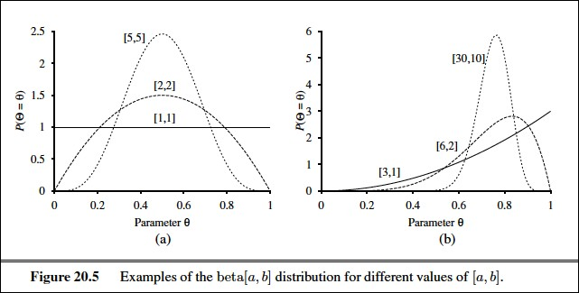
Learning with Complete Data
4) Bayesian parameter learning
Figure shows what the distribution looks like for various values of a and b
Mr. Prayag Patel
Department: IT/ICT-LJIET

Slide 34
Learning with Complete Data
4) Bayesian parameter learning
Suppose that we observe a cherry candy; then we have
𝑃(𝜃 | 𝐷₁ = 𝑐ℎ𝑒𝑟𝑟𝑦) = 𝛼 𝑃(𝐷₁ = 𝑐ℎ𝑒𝑟𝑟𝑦 | 𝜃) 𝑃(𝜃)
= 𝛼′ 𝜃 beta[𝑎, 𝑏](𝜃)
= 𝛼′𝜃 𝜃^{𝑎−1}(1– 𝜃)^{𝑏−1}
= 𝛼′𝜃^{𝑎} 1– 𝜃 ^{𝑏−1}
= beta[𝑎 + 1, 𝑏](𝜃)
Thus, after seeing a cherry candy, we simply increment the 𝑎 parameter; similarly for lime candy and 𝑏 parameter
Thus, we can view the hyperparameters as virtual counts in the sense that a prior beta[𝑎, 𝑏] behaves exactly as
If we had started out with a uniform prior beta[1, 1] and Seen 𝑎 − 1 actual cherry candies and 𝑏 − 1 actual lime candies
Mr. Prayag Patel
Department: IT/ICT-LJIET

Slide 35
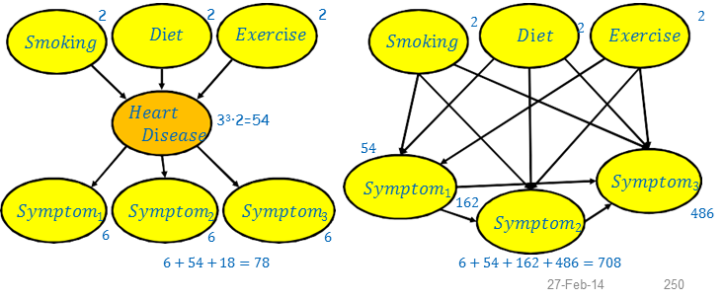
Learning with Hidden variables : The EM algorithm
Many real-world problems have hidden (latent) variables, which are not observable in the data that are available for learning
Including a hidden variable into a Bayesian network may decrease the number of required parameters significantly and, hence, comfort learning of the network
Mr. Prayag Patel
Department: IT/ICT-LJIET

Slide 36
Learning with Hidden variables : The EM algorithm
In the previous example all variables have three possible values yielding two networks with different topologies. The respective total numbers of parameters are 78 and 708
Hidden variables, however, complicate the learning problem
For example, how to learn the conditional distribution for 𝐻𝑒𝑎𝑟𝑡𝐷i𝑠𝑒𝑎𝑠𝑒, given its parents, because we do not know the value of 𝐻𝑒𝑎𝑟𝑡𝐷i𝑠𝑒𝑎𝑠𝑒 in each case?
The same problem arises in learning the distributions for the symptoms
We describe an algorithm called expectation-maximization (EM), that solves this problem in a very general way
Mr. Prayag Patel
Department: IT/ICT-LJIET

Slide 37
Learning with Hidden variables : The EM algorithm
Unsupervised clustering
Discerning multiple categories in a collection of objects without category labels
Clustering presumes that the data are generated from a mixture distribution 𝑃
Such a distribution has 𝑘 components, each of which is a distribution in its own right
A data point is generated by first choosing a component and then generating a sample from that component
Let random variable 𝐶 denote the component, with values 1,…, 𝑘
The mixture distribution is given by
𝑘
𝑃(x) = ∑ 𝑃(𝐶 = i) 𝑃(x | 𝐶 = i),
i=1
where 𝑥 refers to the values of the attributes for a data point
Mr. Prayag Patel
Department: IT/ICT-LJIET

Slide 38
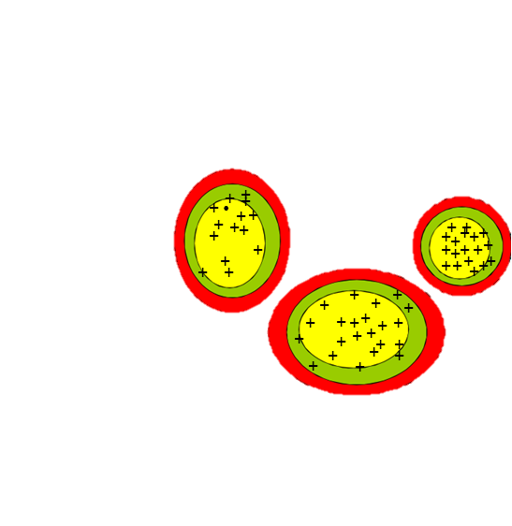
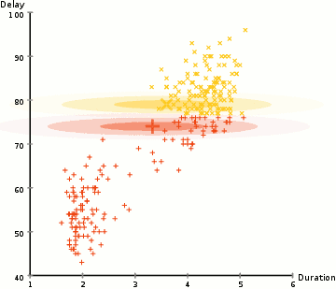
Learning with Hidden variables : The EM algorithm
Unsupervised clustering
Mr. Prayag Patel
Department: IT/ICT-LJIET

Slide 39
Learning with Hidden variables : The EM algorithm
Unsupervised clustering
For continuous data, a natural choice for the component distributions is the multivariate Gaussian, which gives the so- called mixture of Gaussians family of distributions.
The parameters of a mixture of Gaussians are
  The weight of each component 𝑤_{i} = 𝑃(𝐶 = i) and
  The mean 𝜇_{i} and covariance ∑_{i} of each component.
The unsupervised clustering problem is to recover a mixture model that is/could be the source of the data.
Mr. Prayag Patel
Department: IT/ICT-LJIET

Slide 40
Learning with Hidden variables : The EM algorithm
Unsupervised clustering
If we knew which component generated each data point, then it would be easy to recover the component Gaussians.
If, on the other hand, we knew the parameters of each component, then we could, at least in a probabilistic sense, assign each data point to a component.
The problem is that we know neither the assignments nor the parameters.
Mr. Prayag Patel
Department: IT/ICT-LJIET

Slide 41

Learning with Hidden variables : The EM algorithm
Learning hidden Markov models
hidden Markov model can be represented by a dynamic Bayes net with a single discrete state variable
the problem is to learn the transition probabilities from a set of observation sequences
To estimate the transition probability from state i to state j
we simply calculate the expected proportion of times that the system undergoes a transition to state j when in state i:
Mr. Prayag Patel
Department: IT/ICT-LJIET

Slide 42
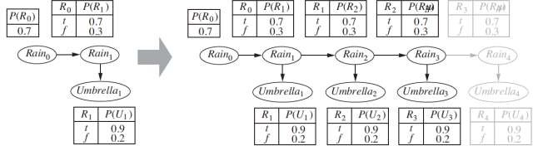
Learning with Hidden variables : The EM algorithm
Learning hidden Markov models
Mr. Prayag Patel
Department: IT/ICT-LJIET

Slide 43
Learning with Hidden variables : The EM algorithm
The general form of the EM algorithm
The Expectation-Maximization (EM) algorithm is a way to find maximum-likelihood estimates for model parameters when your data is incomplete, has missing data points, or has unobserved (hidden) variables.
It works by choosing random values for the missing data points, and using those guesses to estimate a second set of data. The new values are used to create a better guess for the first set, and the process continues until the algorithm converges on a fixed point. See also: EM Algorithm explained in one picture
Mr. Prayag Patel
Department: IT/ICT-LJIET

Slide 44
Learning with Hidden variables : The EM algorithm
The general form of the EM algorithm
Algorithm:
Given a set of incomplete data, consider a set of starting parameters.
Expectation step (E – step): Using the observed available data of the dataset, estimate (guess) the values of the missing data.
Maximization step (M – step): Complete data generated after the expectation (E) step is used in order to update the parameters.
Repeat step 2 and step 3 until convergence.
Mr. Prayag Patel
Department: IT/ICT-LJIET

Slide 45
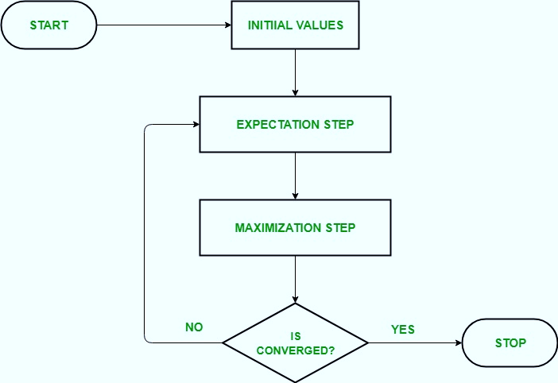
Learning with Hidden variables : The EM algorithm
The general form of the EM algorithm
Mr. Prayag Patel
Department: IT/ICT-LJIET

Slide 46
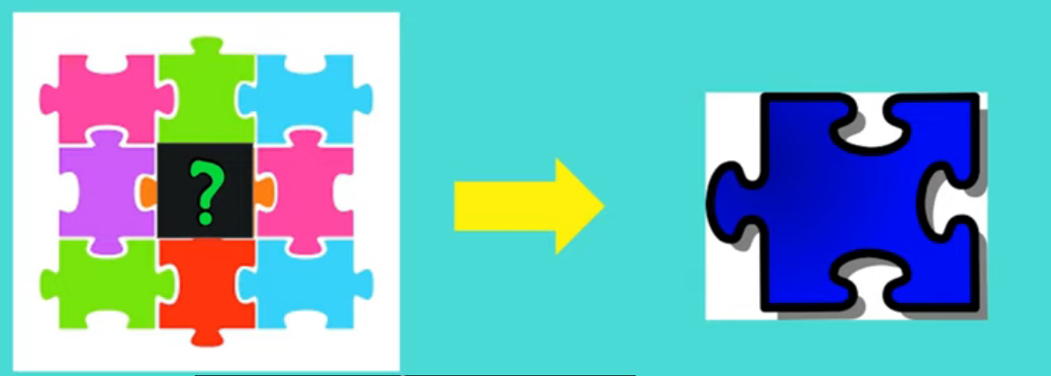
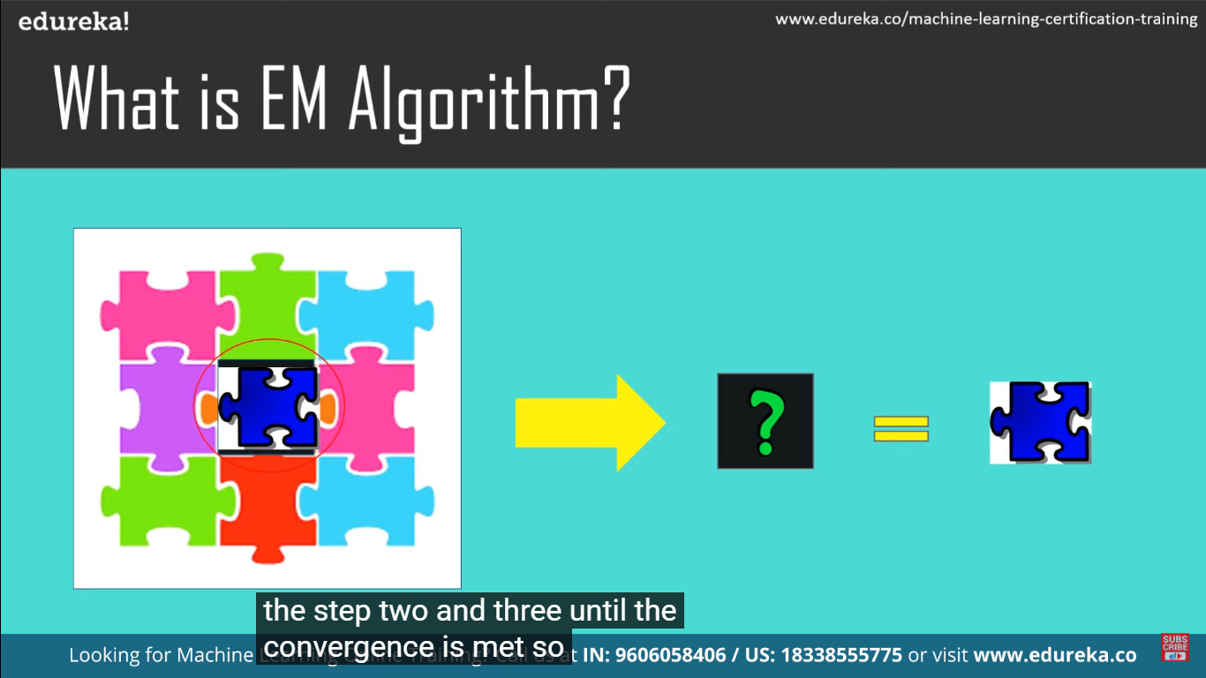
Learning with Hidden variables : The EM algorithm
The general form of the EM algorithm
Mr. Prayag Patel
Department: IT/ICT-LJIET

Slide 47
Learning with Hidden variables : The EM algorithm
The general form of the EM algorithm
Let x be all the observed values in all the examples, let Z denote all the hidden variables for all the examples, and let θ be all the parameters for the probability model.
The E-step is the computation of the summation, which is the expectation of the log likelihood of the “completed” data with respect to the distribution P(Z=z | x, θ(i))
The M-step is the maximization of this expected log likelihood with respect to the parameters.
Then the EM algorithm is
Mr. Prayag Patel
Department: IT/ICT-LJIET

Slide 48
Thank you for watching ..
Mr. Prayag Patel
Prayag.patel@ljinstitutes.edu.in

